Slide 1
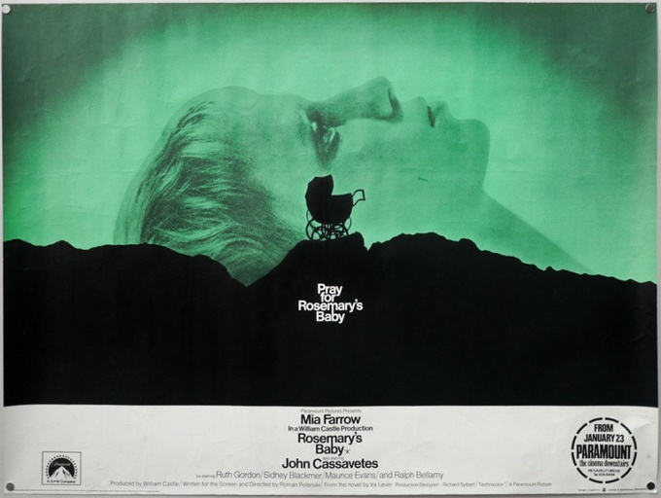
Movie
Poster
Analysis
Rosemary's
Baby
(1968)
Ashley Gonzalez MEDPL 150

Slide 2
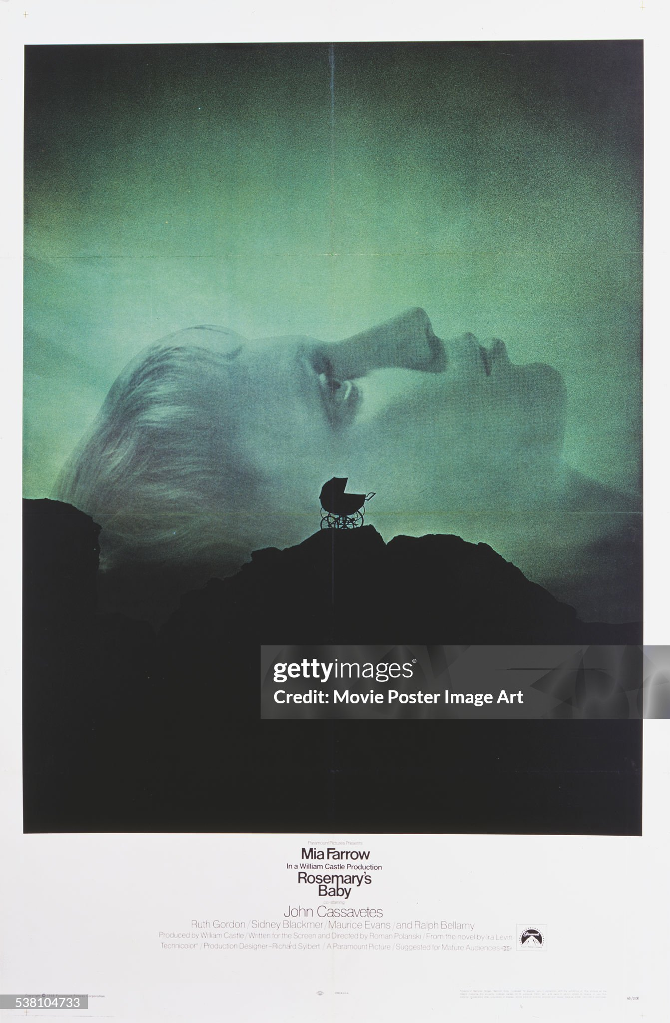
Context
Themes
1968
Beginning of Second Wave Feminism Movement
Pre-Roe v. Wade
Modernist style
Graphic Designer: Philip Gips
Genre: Horror/Psychological
Agency
Capitalism
Motherhood

Slide 3
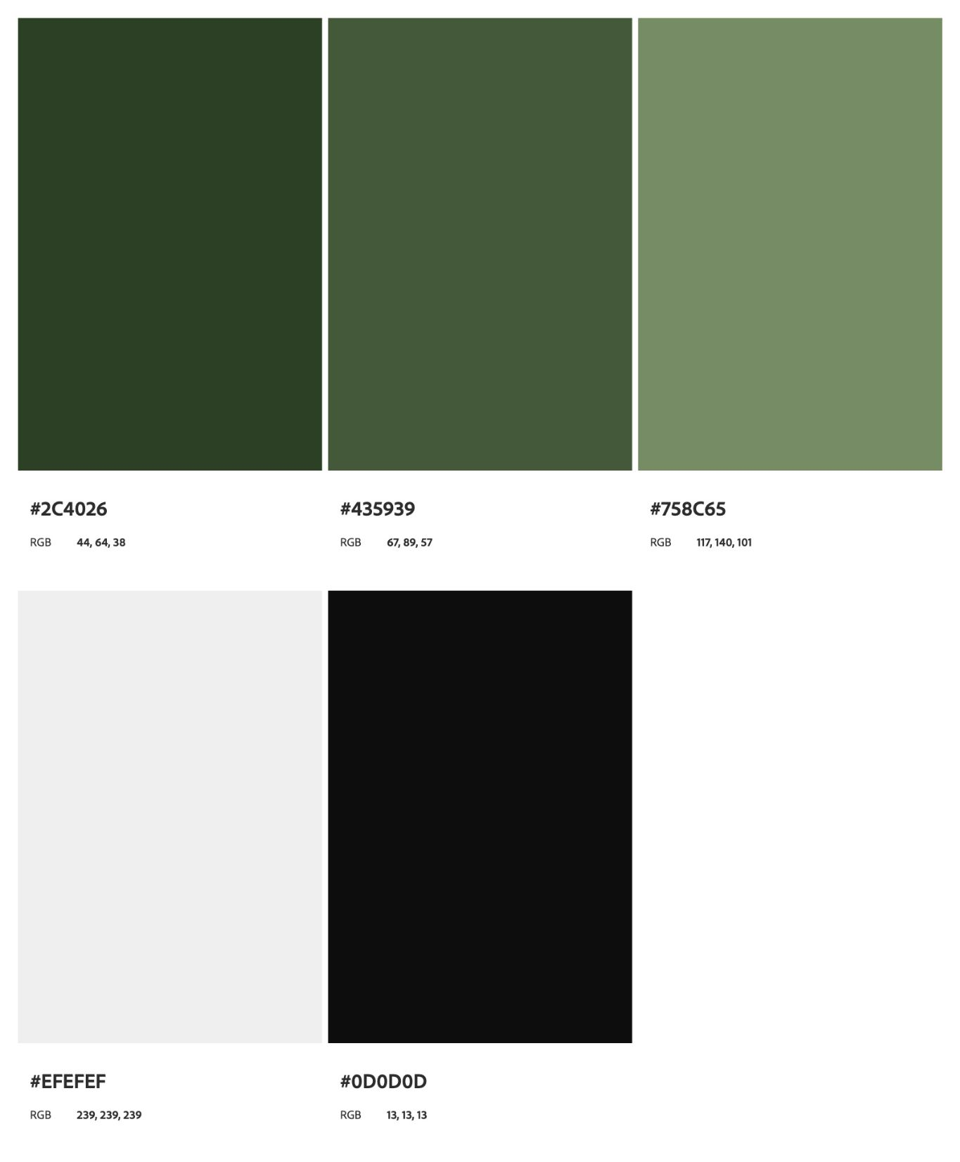
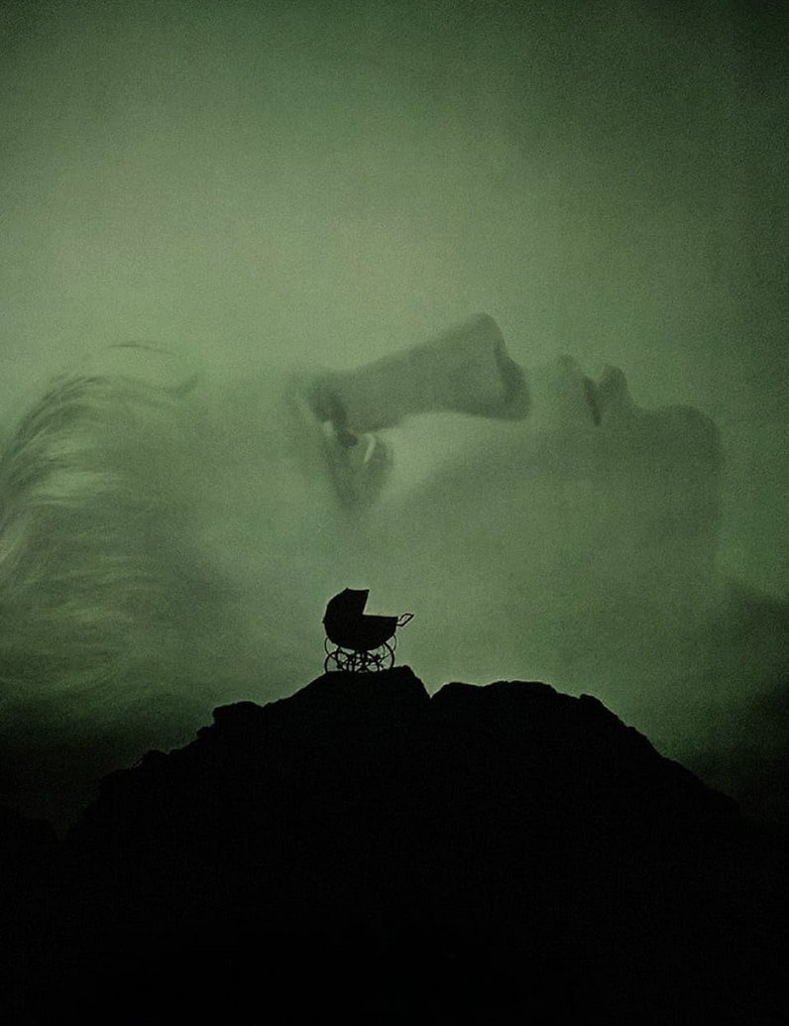
Economy
Negative space
2 objects: silhouette of carriage, Rosemary’s profile
Monochromatic Color Scheme

Slide 4
Color
Monochromatic Color Scheme
Green: fertility, sickness
Black: silhouette, dominant negative space

Slide 5
Composition and Space
Rule of Thirds
Top: Green negative space
Middle : Rosemary’s profile and silhouette of baby carriage
Bottom: Black Cliff/Mountain negative space
Top and Bottom enclose and oppress Rosemary.
Rosemary pushed into background while carriage is pulled forward.

Slide 6


Modernist typeface: Sans Serif
Typeface: Leading, Tracking, Kearning are tightknit (ie:the “r”,“y” and apostrophe overlapping)
Colors: white text on black / black text on white
Late modernist poster: Grid, Clarity, minimalist
Centered Alignment

Slide 7
Grid: secrets hiding in orderly structure, asymmetrical layout as inverted cross
Font: claustrophobic in negative space , the “m” and “b” connecting
Movement: downwards (descent), repetition (feeling of inevitability)
Evil
The Occult

Slide 8
Hierarchy
The Baby’s Carriage
Foreground
Absolute Center Point
Black color with negative space becomes dominant
Rosemary
Large in scale…
Rosemary blending into background
Sickly black eyes
Laying down, passivity
What does this poster suggest about how society viewed/views women’s bodies?

